Slide 1
Equivalent Ratios
Year 11 Mathematics

Slide 2
24
7
30
Date: /9/2018
Ratios
EQ – What are equivalent ratios?
Example
What is an equivalent ratio?
If you are making orange cordial and you mix one part cordial to four parts water, then the ratio of cordial to water will be 1:4 (1 to 4).
If you use 1 litre of cordial, you will use 4 litres of water (1:4).
If you use 2 litres of cordial, you will use 8 litres of water (2:8).
If you use 10 litres of cordial, you will use 40 litres of water (10:40).
Notice that if you had a Jug, and mixed in 1L of cordial and 4L of water, it would be 5 litres in total – this is the total parts of the ratio.

Slide 3
24
7
30
Date: /9/2018
Ratios
EQ – What are equivalent ratios?
These ratios are all equivalent
1:4 = 2:8 = 10:40
Both sides of the ratio can be multiplied or divided by the same number to give an equivalent ratio.
To simplify a ratio, you divide both sides of the ratio by the highest common factor.
Note: Make sure both sides of the ratio are using the same units of measurement.
Example:
200g : 1kg Change both sides to the same units
200g : 1000g Divide both sides by the highest common factor
1 : 5
What is an equivalent ratio?

Slide 4
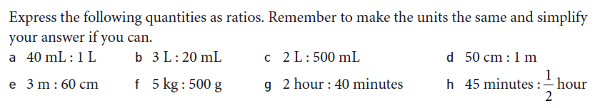
Task

Slide 5
Task
Practice your skills with equivalent ratios on the worksheet provided.

Slide 6
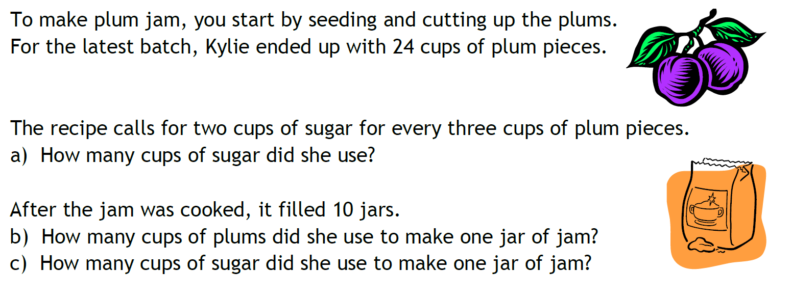
Let’s Try This One

Slide 7
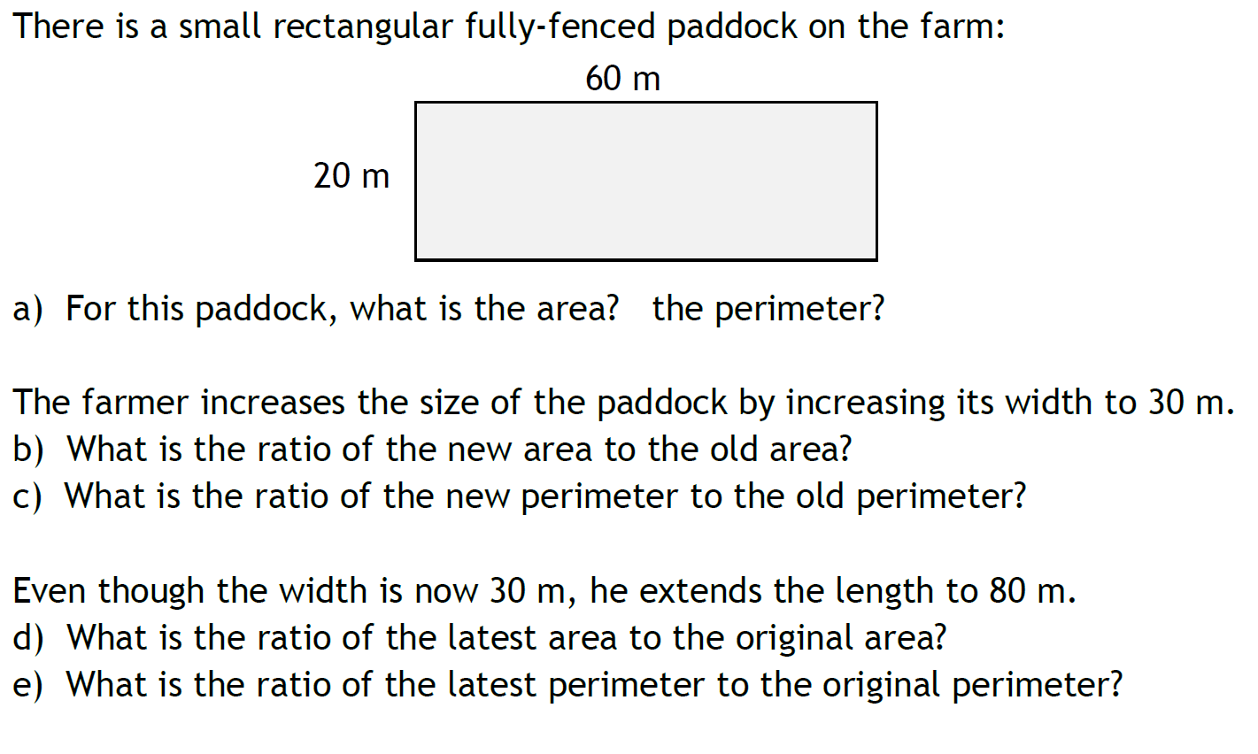
And This One?

Slide 8
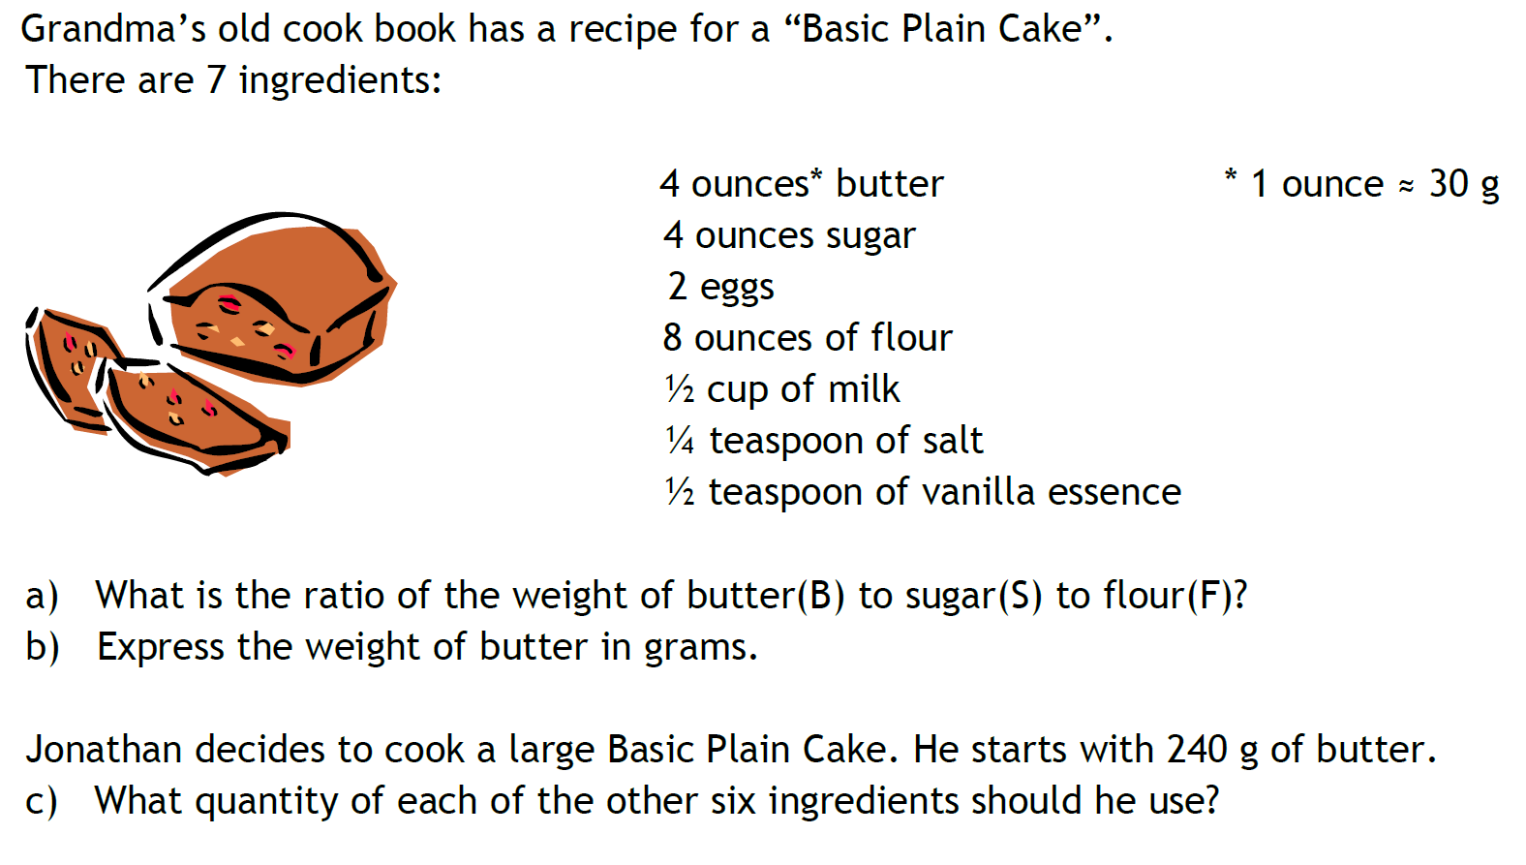
And This One?

